Slide 1
Surviving a School Shooting
Steve Mays
Statistics
Mason High School

Slide 2
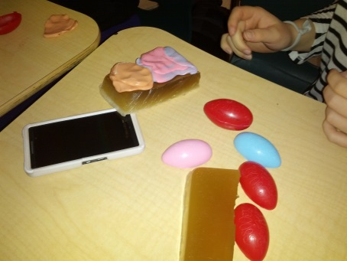
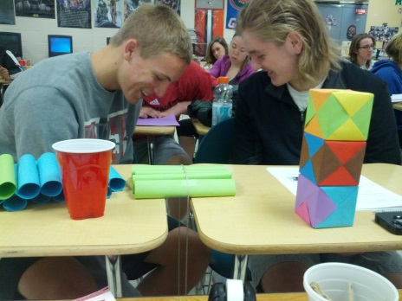
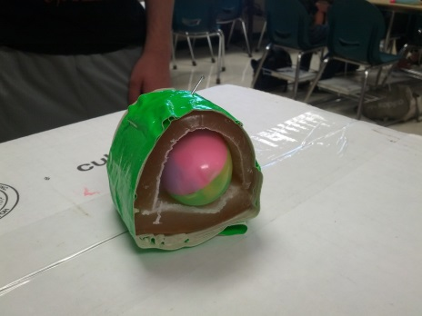
The Big Idea
Technology’s Role In Improving Personal Safety
The Essential Question
How can we help ensure that students, teachers, and staff survive if a school shooting were to occur at our school?
Understand statistics as a process for making inferences about population parameters based on a random sample from that population.
Decide if a specified model is consistent with results from a given data-generating process, e.g., using simulation.

Slide 3
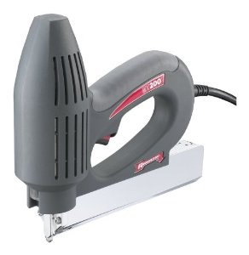
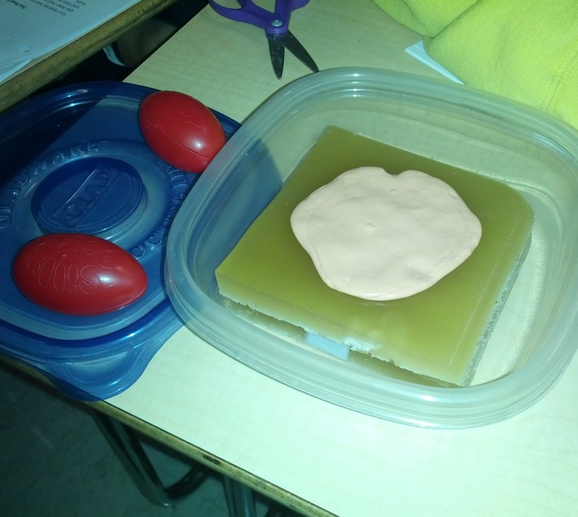
The Challenge
The students’ challenge was to create a “vest” or “blanket” that can “stop or slow down a bullet”. Ultimately their creation will be tested against a projectile that simulates a bullet being shot from a gun.

Slide 4
Guiding Questions
What materials can be used to stop a bullet?
What parts of the body need to be protected?
What common items could be used?
What is already available for personal protection?

Slide 5
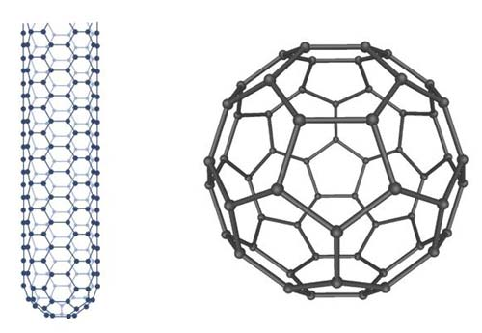
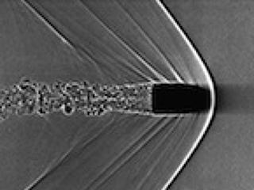
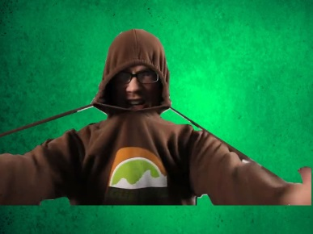
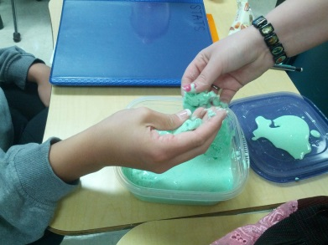
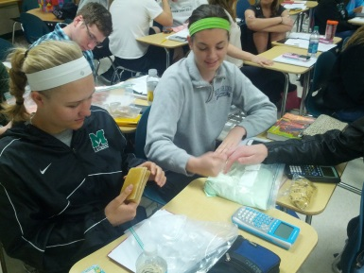
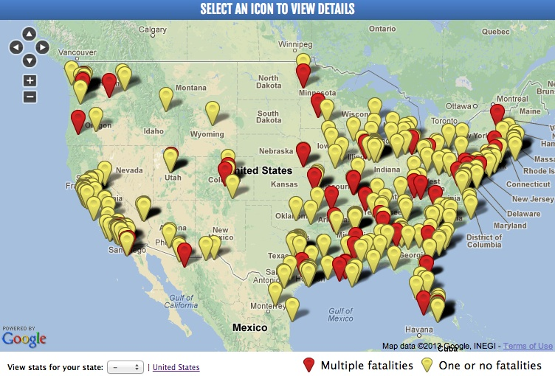
ACS
Application- Nanotechnolgy, NN Fluids
Career Awareness
Societal Impact

Slide 6
Evidence of Student Learning
On the pre-assessment, my students had very limited knowledge of the statistical goals (confidence intervals).
After the Unit was complete, 90% of my students that took the post-assessment received a perfect score.

Slide 7
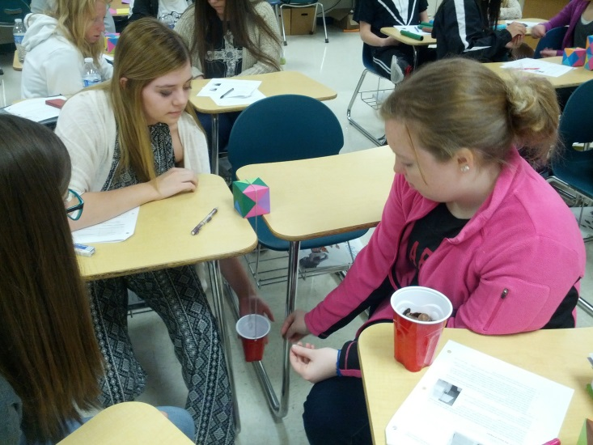
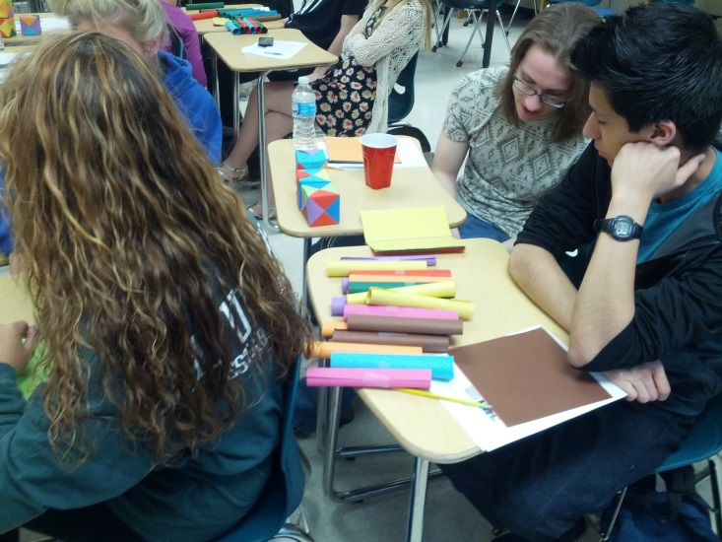
Activities
Activity 1 – Introducing the Big Idea
Activity 2 – Research
Activity 3 – Using Origami to Simulate Nanotechnology.

Slide 8
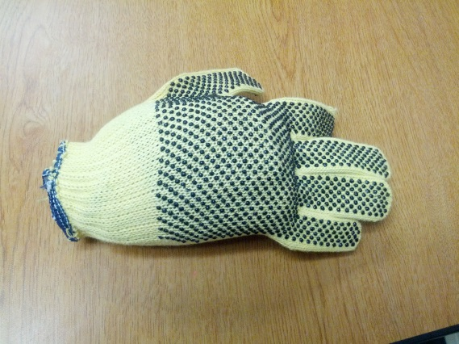
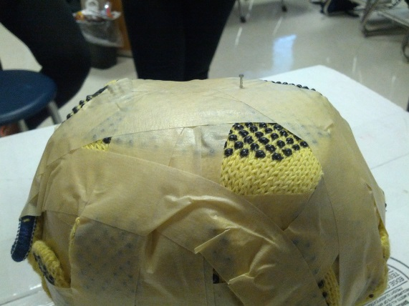
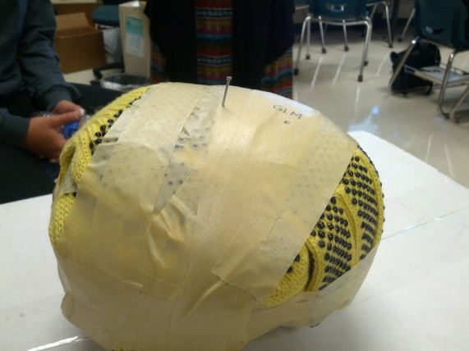
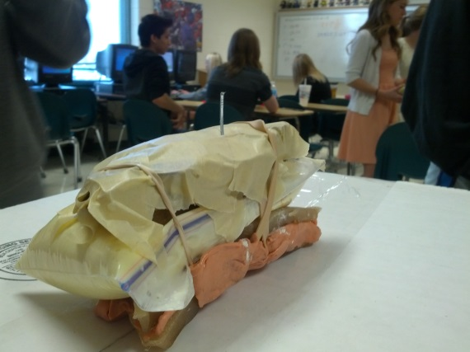
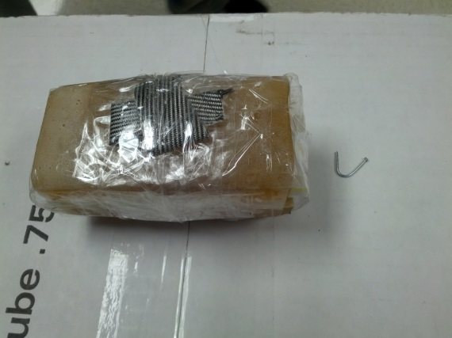
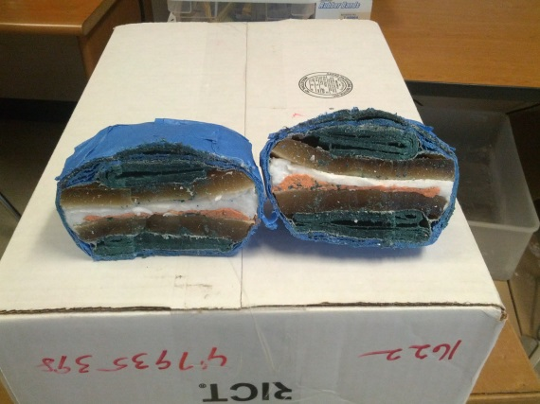
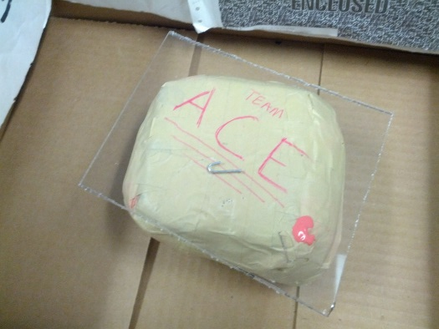
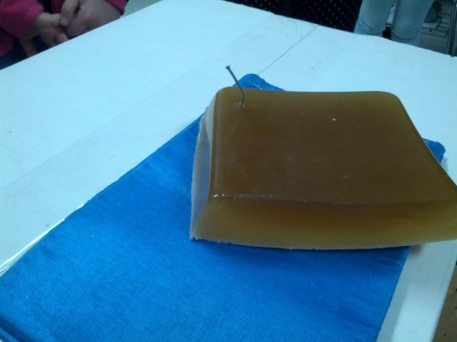
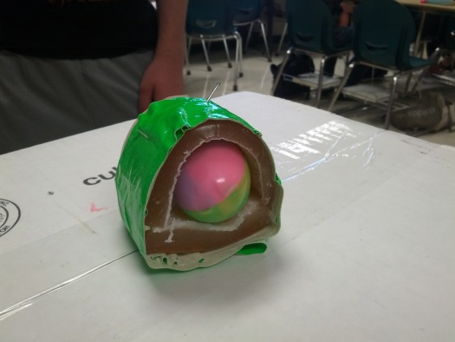
Activities
Activity 4 – The Final Four of NN Fluids

Slide 9
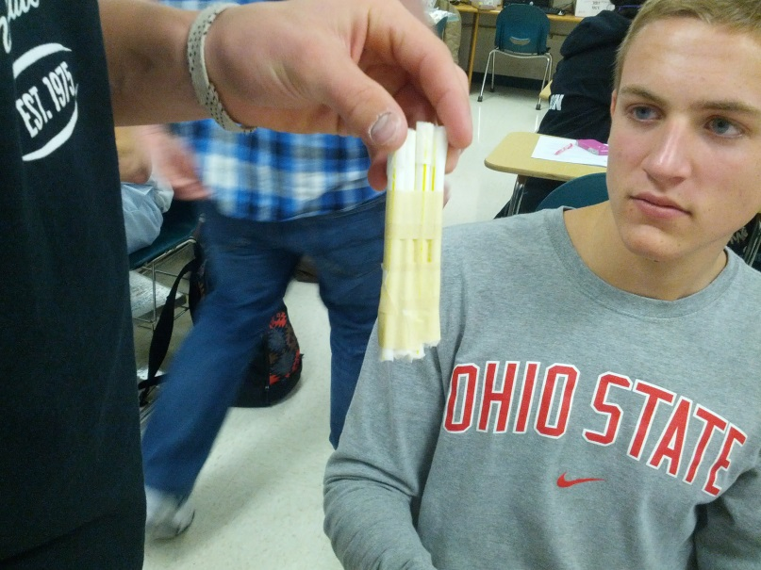
Reflections
Engaged students = Student Learning
Application Leads to Interest
Balancing Time is a Challenge
Smaller Groups Could be More Effective

